Slide 1
Property Rights
By Trevor Merritt.

Slide 2
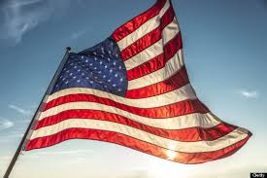
Affirmative.
I believe that The U.S. gov should be increasing the protection of property rights to those who create and distribute digital products.
I believe this due to the fact that companies lose money everyday due to those who decide to pirate CD’s or DVD’s.
In order to protect these property rights however, would require a lot of resources to keep track of upload sites or digital download usages, perhaps maybe a way to keep track of those allowed devices.

Slide 3
Side Effects
With this there would be tremendous side effects such as, loss of money, possible device monopoly, as well as streaming services such as Spotify losing business.
With property rights you can’t always be tracking them so the amount of resources needed would be enormous compared to the possible catching of piraters.

Slide 4
Thanks for Watching.

